Slide 1
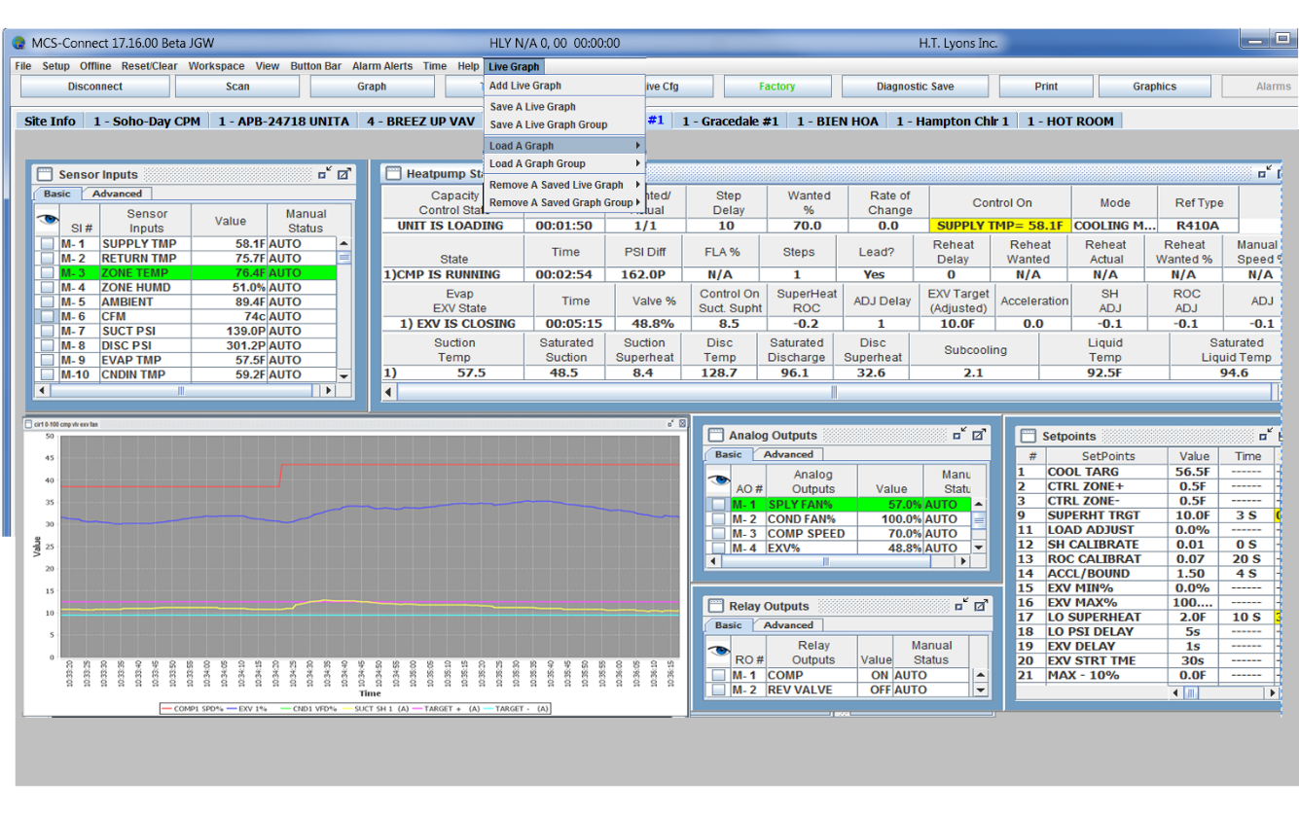
MCS-Connect
All features in this presentation are available in version 18.27.17 and greater
Support for all Products: support@mcscontrols.com
Application Specialist: Firmware/Software: applications@mcscontrols.com
Sales for all products: sales@mcscontrols.com
General Pricing and Orders – orders@mcscontrols.com
Status-Orders and Shipping - orders@mcscontrols.com
RMA (Return Merchandise Authorization):orders@mcscontrols.com
Revision K02 - 1/7/2020
Notes:
Change all frames to windows

Slide 2
Overview
Intro to MCS-Connect
Connection and Setup
Display
Menus
Graphing – ‘LIVE’ and ‘STATIC’
Graphics
Uses in troubleshooting

Slide 3
Intro to MCS Connect
Windows®-based (Windows® XP thru win 10)(.exe File)
Software written in Java
Linux version for touchscreens(7, 10.1, 15.4 inch)(.jar File)
Window frames with values updated in real time
Updated approximately every 1 to 3 seconds
Supports up to 40 MCS controllers
Status, Trending/Graphs, Schedules
Transmit / Receive Configuration (.cfg File)
Load Firmware (.hex File)
Expanded Graphing

Slide 4
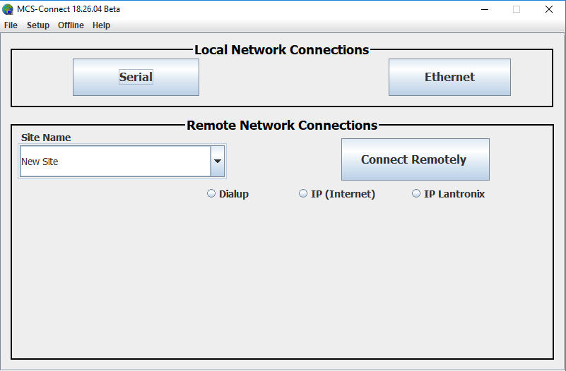
Connection Types
Can connect locally (Serial or Ethernet)
Can connect remotely to a MCS controller with internet access using Dialup, IP(Internet) and IP Lantronix

Slide 5
Serial or Ethernet Connections
Serial Connections - Direct connection using RS-485 cable from Laptop or computer.
(serial connection must be used when uploading new firmware to your MCS controller).
Ethernet Connections - using an RJ-45 cable, you can connect through a server in the plant or office to multiple MCS controllers.

Slide 6
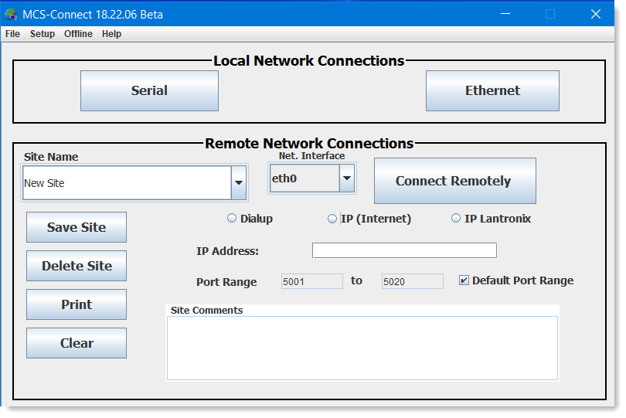
Local & Remote Connections
Job site connection settings can be saved
Remote connections are available through
Dialup using a MCS-Modem
IP (Internet) IP address and Port Range
IP Lantronix
Enter a ‘job site name’
IP Address, port number to search.
Site comments, ‘Connect Remotely’
SITE 5580
192.168.18.101
‘Connect Remotely’
To Enter Port Range, click off ‘Default Port Range’

Slide 7
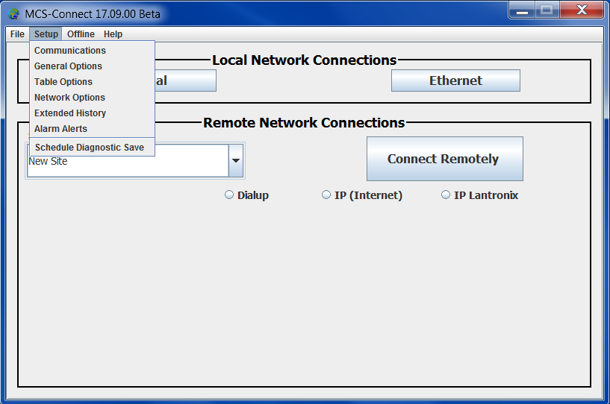
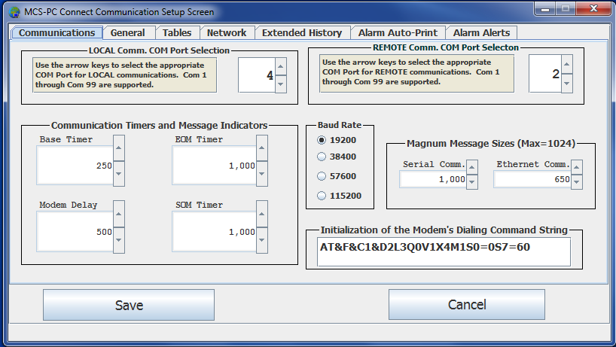
Communication Setup
Communication Setup can be opened with the menu bar under ‘Setup  Communication’
The Communications tab allows for selection of messaging settings & selection of a COM Port

Slide 8
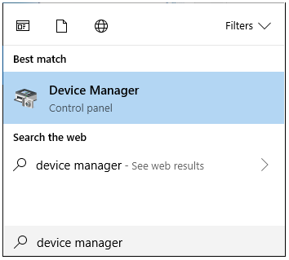
Determining Current COM Port
Selecting the correct COM port is required for any serial connection
Open the Device Manager through the Control Panel or search programs for ‘device manager’
Find the port number of the connected serial port

Slide 9
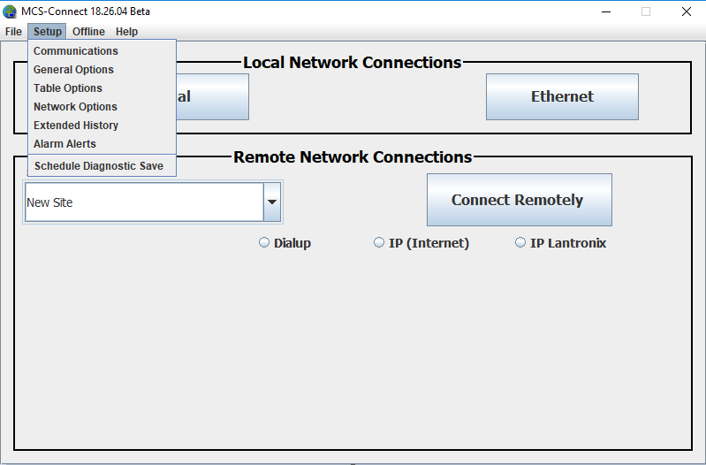
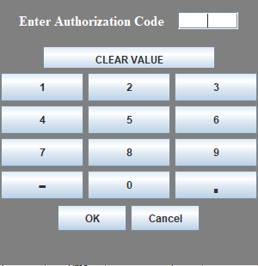
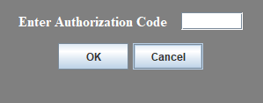
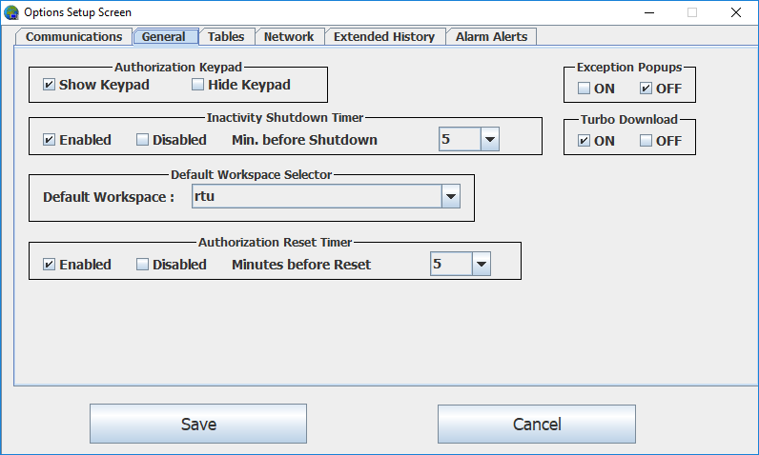
General Options Setup
HIDE
KEYPAD
SHOW
KEYPAD
General Options tab
Exception Popups
Show/ Hide Keypad
Inactivity Shutdown Timer
Turbo Download
Default Workspace
Authorization Timer
Save any Changes

Slide 10
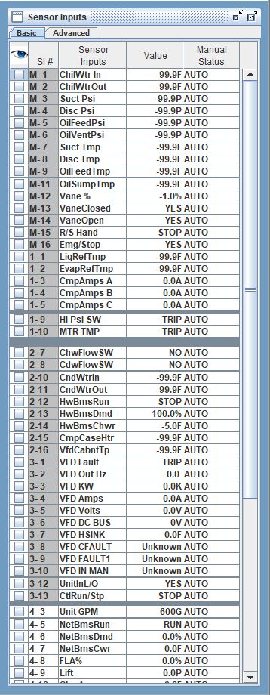
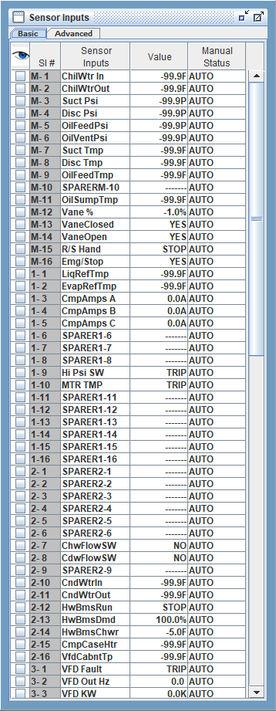
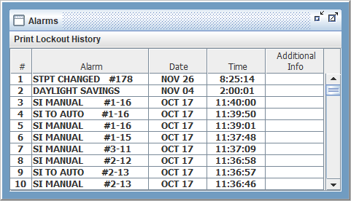
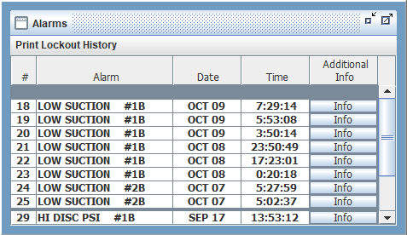
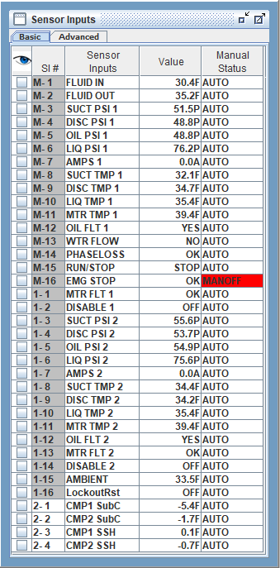
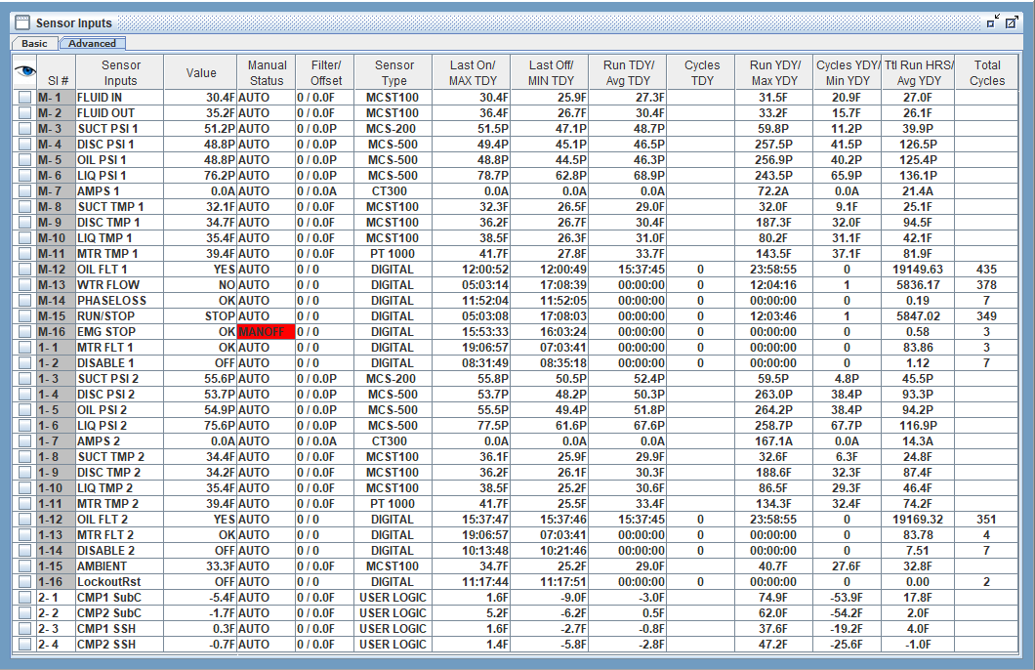
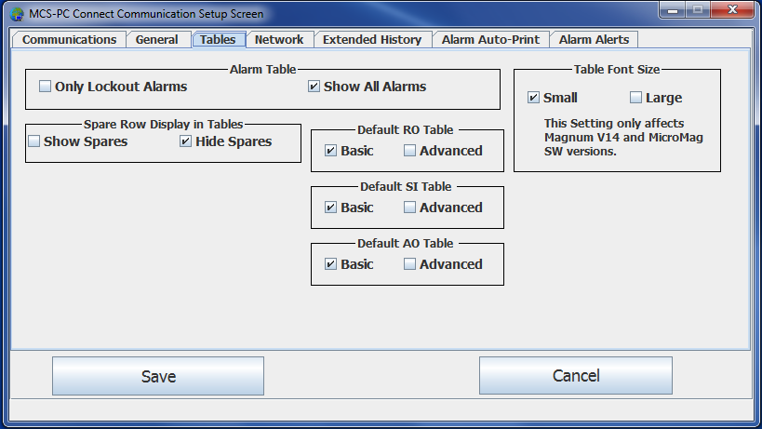
Tables Options Setup
SPARES
SHOWN
ALL
ALARMS
LOCKOUTS
ONLY
SPARES
HIDDEN
BASIC
WINDOW
ADVANCED
WINDOW
Tables tab- setup how tables appear
Alarms
Hide Spare Rows
Basic or Advanced
Save any Changes

Slide 11
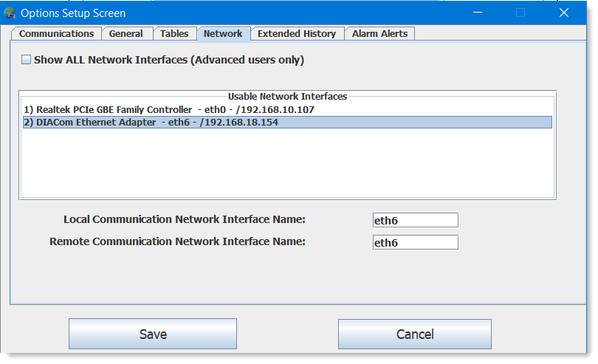
Network Options Setup
If you have more than one network interface you may need to select the correct one here.
A network adapter was added for a wireless modem connection
Click on which adapter you want Save any Changes

Slide 12
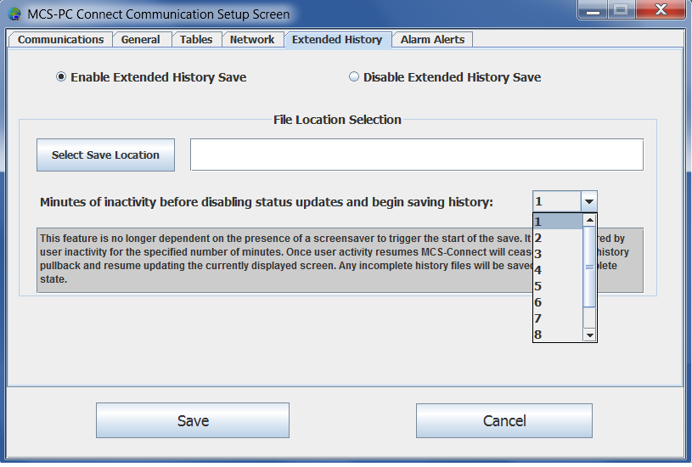
Extended History Setup
Extended History File Setup tab
Enable Extended History Save
Select Save
Location
Set inactivity timer
in which Connect
will stop updating
status and will start
logging history files.
C:\MCS\Extended History
Click to Save changes

Slide 13
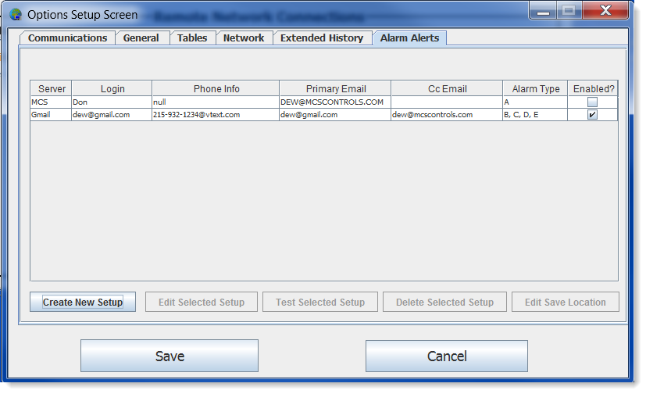
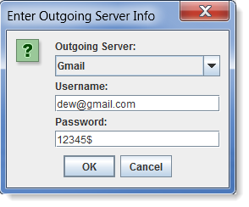
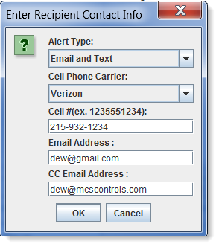
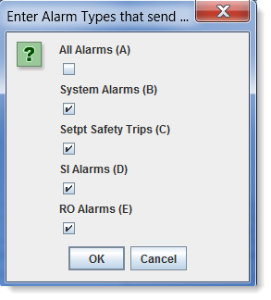
Alarm Alerts Setup
Alarm Alerts - Setup Email and/or Text Alerts
Magnum must have access to the internet
Enter the
Outgoing Server Press OK when complete
Enter Recipient Contact Info, Email and Text
Press Ok when complete
Enter Alarms Types to receive

Slide 14
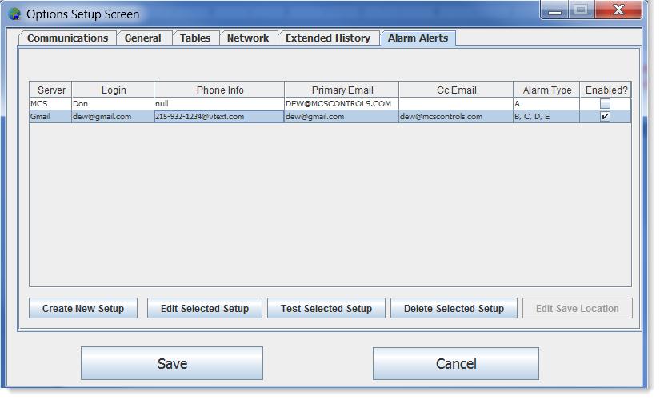
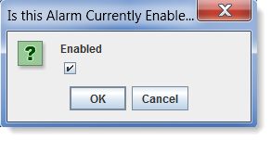
Alarm Alerts (cont)
Alarm Alerts - (continued)
Enabled
Test a Setup
Edit a Setup
Delete a Setup
Save all Changes

Slide 15
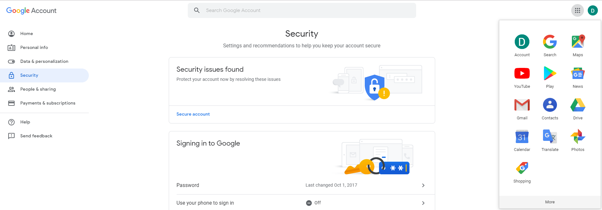
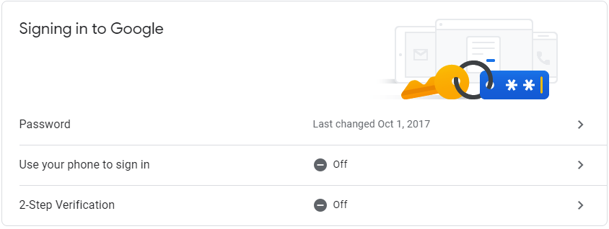
Alarm Alerts (cont) Gmail Account Setup
Log into your Gmail account and navigate to your Google Account Security settings.
Verify ‘2-Step Verification’ is Off
Verify ‘Less secure app access’ is set to On
If either of these settings are setup incorrectly MCS Connect will not be able to access the Gmail account to send out alarm alerts.

Slide 16
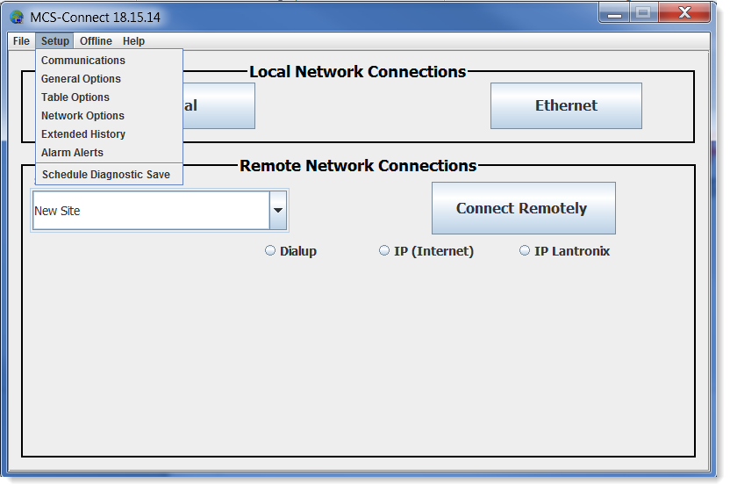
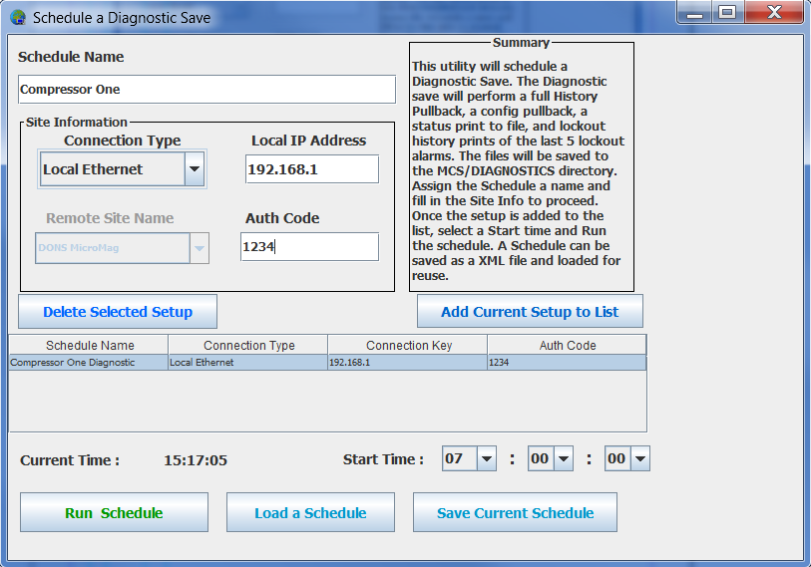
Diagnostic Save Setup
Diagnostic Save – Schedule a Diagnostic Save
Performs a Full History Pullback
Current Config Pullback
Current Status Print to File
Lockout History Prints of Last 5 Lockout Alarms
Add Current Setup to List
Schedule Name
Connection Type
IP Address
Auth Code
Delete Selected Setup
Run Schedule
Save Current Schedule
Load a Schedule

Slide 17
Device Tabs
This is the initial view after a successful connection. Here we have multiple MCS controllers connected on the same ‘ETHERNET’ network. If you were connected by ‘SERIAL’ you would see only one controller, unless you are daisy chained using RS485.
Each MCS controller has its own tab and can be viewed by pressing the corresponding tab.

Slide 18
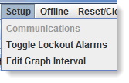
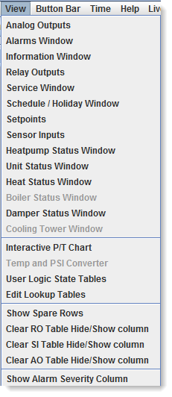
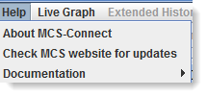
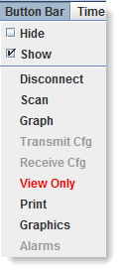
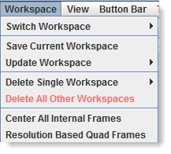
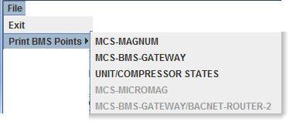
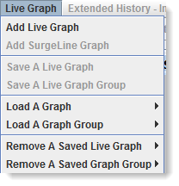
Menu Bar
Notes:
Edit Description

Slide 19
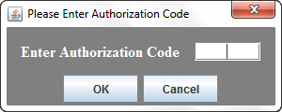
Authorization
Authorization
Clicking on the authorization level button prompts for a code to change the authorization level.
Some functionality requires higher authorization, Transmit new config, Receive a config from the controller, etc.
These items are grayed out until the proper code is entered.

Slide 20
Workspaces
A workspace is a custom layout of moved and resized frames.
Your current workspace can be saved in the Workspace menu in the Menu Bar.
The Workspace menu is also used for managing or switching workspaces.

Slide 21
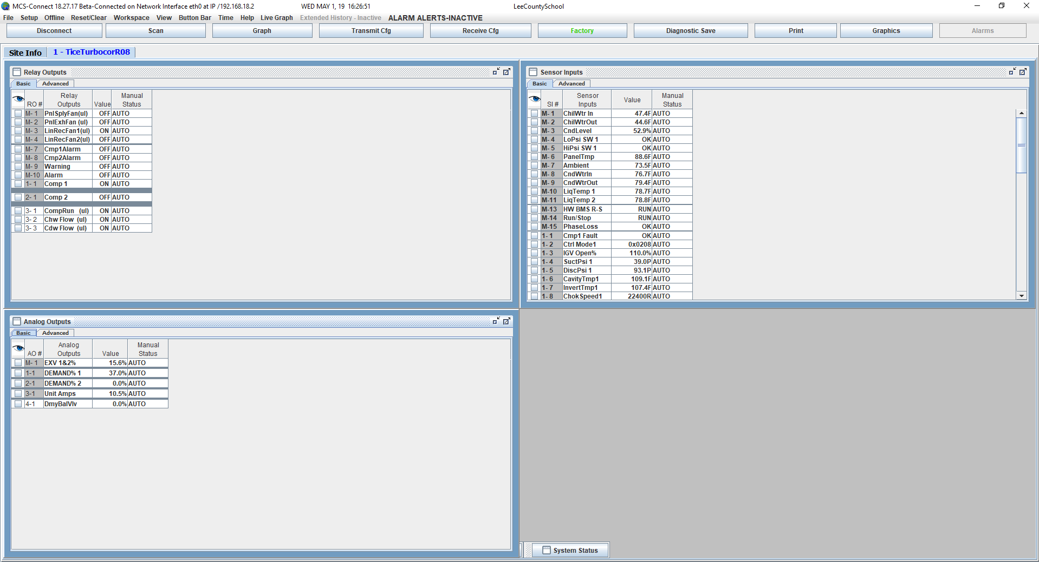
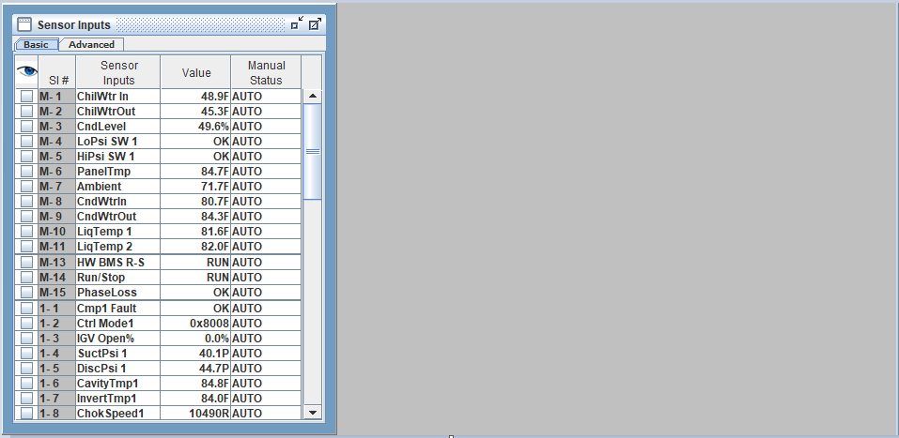
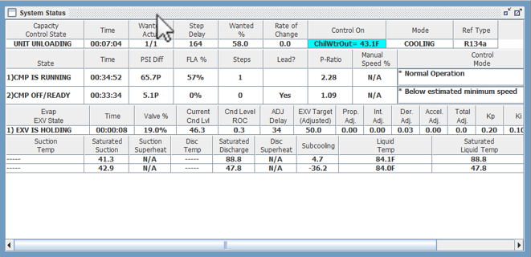
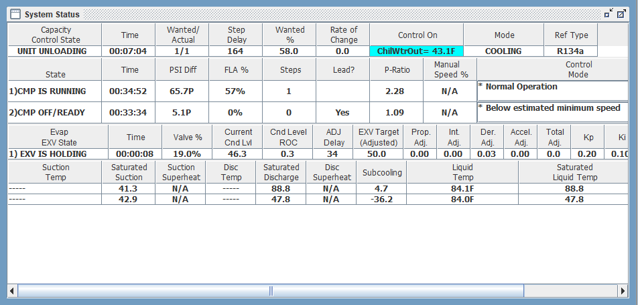
Workspaces Adjusting Frames

Slide 22
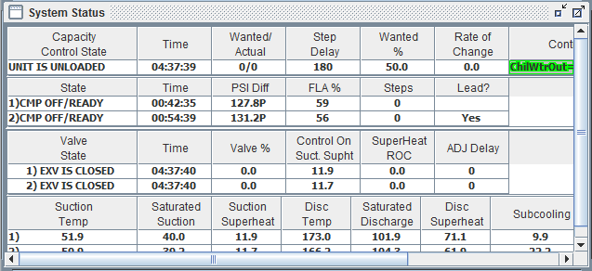
Workspaces Adjusting frames
Organized into adjustable and resizable frames
Window layouts are customizable and can be saved

Slide 23
Transmit / Receive Config
Receive Cfg: Pulls a copy of the .cfg file from the controller for analysis
Transmit Cfg: Sends a .cfg file to the controller (overwrites the existing .cfg)
Requires authorization level of Supervisor or greater for both Receive and Transmit Config

Slide 24
Load Firmware
Loads a .hex firmware file into the MCS controller (overwrites the existing firmware)
Requires authorization of Service or higher

Slide 25
Frames
Frames can be minimized and maximized
Can be adjusted to full screen
Highlighting can be added on click
List of frames:
Alarms
Analog Outputs
Information
Relay Outputs
Schedule
Sensor Inputs
Service
Set points
System Status
Boiler Status
Unit Status
(RTU Only)
Heat Status
(RTU Only)

Slide 26
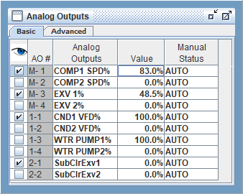
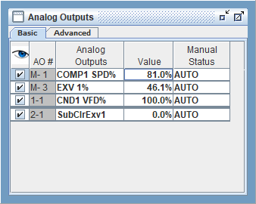
Hide/Show Rows
The ‘Hide/Show’ icon toggles the visibility of inputs/outputs displayed on the screen. In this example things relating to circuit #1 are selected.
Then click the “eye” and all unselected items will be hidden.
Click the “eye” again to bring all unselected items back into view.
The Hide/Show column is located in the:
Analog Outputs frame
Relay Output frame
Sensor Inputs frame

Slide 27
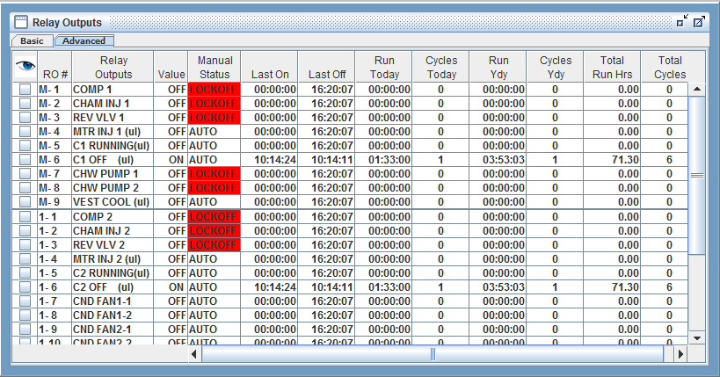
Relay Outputs Frame
Displays the status of all relay outputs
Hide/Show rows can be toggled off and on as was shown in the Hide/Show screen shot.

Slide 28
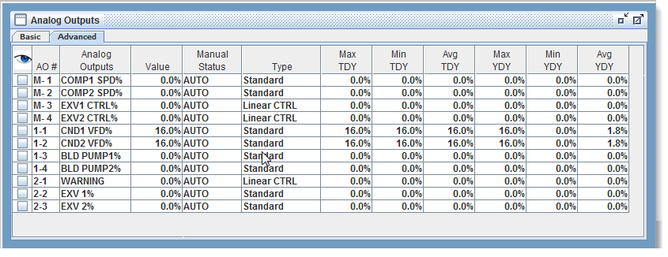
Analog Outputs Frame
Displays the status of all Analog outputs
Hide/Show rows can be toggled off and on as was shown in the Hide/Show screen shot.

Slide 29
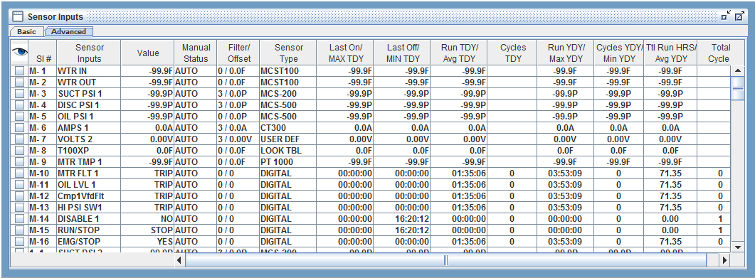
Sensor Inputs Frame
Displays the status of all sensor inputs
Hide/Show rows can be toggled off and on as was shown in the Hide/Show screen shot.
Notes:
Add animation about each column

Slide 30
Information Frame
Gives the most recent messages to the user including frame information and connection status

Slide 31
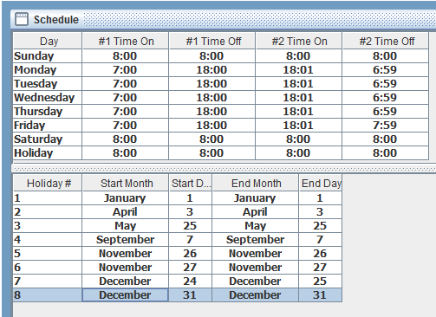
Schedule Frame
Manages the unit’s weekly scheduled run time as well as setting holidays
Each day has two Time On and Time Offs for separate schedules
0:00 ON // 0:00 OFF = Always off
0:00 ON // 24:00 OFF = Always on
Notes:
Add in holiday information that you can have 8 and it follows the special holiday schedule

Slide 32
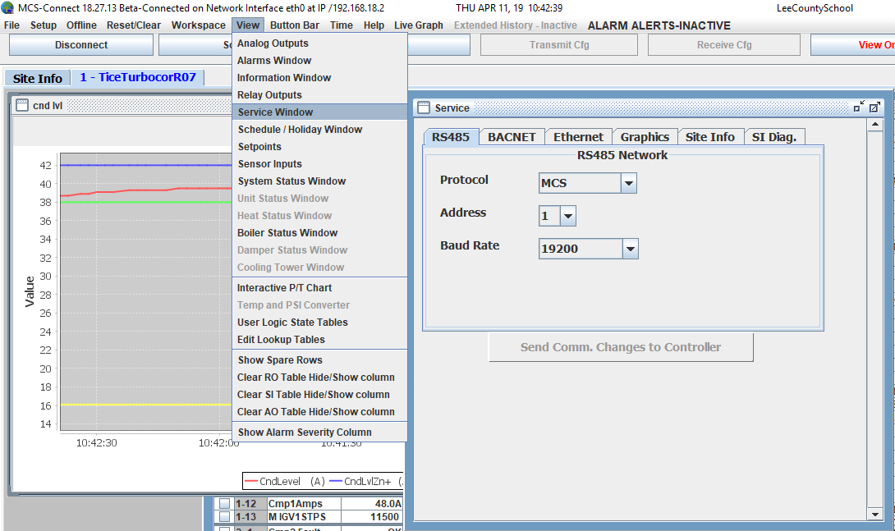
Service Frames
By clicking on ‘View’ and selecting ‘Service Window’ in the drop down menu you will open
the below service window that gives you access to six different tabs. You must be authorized
to make any changes.
RS485
BACNET
Ethernet
Graphics
Site Info
SI Diag.
Notes:
Changing Ethernet setting require a reset of the magnum

Slide 33
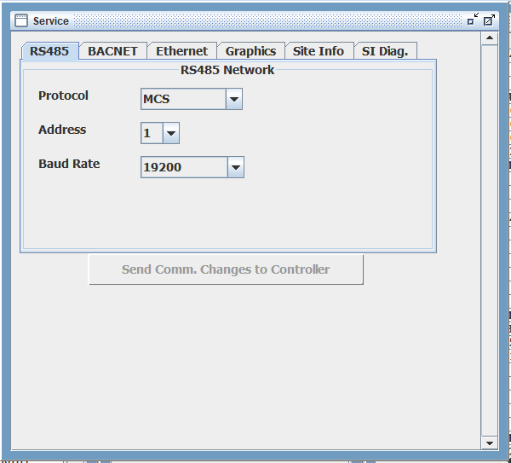
Service Frames RS485 Protocol
The RS485 tab allows you to change the Protocol, Address, and Baud Rate of the controller.
MCS protocol allows communication with MCS Connect software.
MODBUS RTU protocol allows communication to a front end system.
CPM protocol used for slave Magnums to communicate and follow commands of
a master Magnum controller.
MCS Connect software will only
communicate over RS485 to a board
setup on the MCS protocol.
Otherwise an ethernet connection
is required for communications.

Slide 34
Service Frames RS485 Address
Address can be set from 0-99 for each controller.
Each controller on the same RS485 daisy chain needs to be addressed differently.
MCS Connect scans for 1 address at a time, starting at 0. So depending on the address selected you’ll have to wait an extended amount of time for a higher address to be found.

Slide 35
Service Frames RS485 Baud Rate
The RS485 baud rate of the controller can be changed to 19200, 38400, 57600, and 115200.
MCS Connect software baud rate must match controllers baud rate in order to communicate.
Once your changes are made you must
click send comm changes to controller
for changes to take effect.

Slide 36
Service Frames BACNET
The BACNET tab allows you to change the address(BACNET ID) and BACNET port
The address is used to identify the controller over a network
Bacnet Port standard is 47808
for Bacnet over IP traffic but
can be changed based on jobsite
requirements.
If you check the limit address box
the address range will be limited
to 18100 to 18199 which is the
default range MCS uses.
Once your changes are made you must
click send comm changes to controller
for changes to take effect.

Slide 37
Service Frames Ethernet
The Ethernet tab allows you to assign an IP address, subnet mask, default gateway,
and MCS port. It also displays the Magnum’s MAC address.
You also have the ability to set the Magnum to look for a dynamic IP from a router by
selecting the yes radio button.
Magnum must be power
cycled for an IP change to take effect!!
Once your changes are made you must
click send comm changes to controller
for changes to take effect.

Slide 38
Service Frames Graphics
The Graphics tab allows you to select the appropriate file path for displaying graphics
on an MCS touchscreen.
abc/systemoverview.xml
Default Windows path - C:/MCS/GRAPHICS/
Default Linux path - /home/ubuntu/MCS-Connect/MCS/Graphics/
abc/systemoverview.xml
In this example you will have
an abc folder and inside that abc
folder will be a systemoverview.xml
file. The default graphics path is
already determined by MCS Connect
so all that needs to be done is to add
the rest of the file path so MCS
Connect can access the files.
Once your changes are made you must
click send graphics file changes to
controller for changes to take effect.

Slide 39
Graphics
Custom dynamic graphics can be added to MCS-Connect giving a real-time animated view of each unit

Slide 40
Service Frames Site Info
The Site Info will provide information pertaining to your controller. This window is view
only and cannot be modified.
HW Serial # - Serial number of board
Cfg Date – Last time the config was modified
Cfg Vers. – Version of config file
Unit Model # - if provided
Unit Serial # - if provided
Install Date – Date config was made
Current Firmware – What’s currently loaded
into board
Tech Name – Creator of config
Testing Firmware – Firmware used for testing
config in factory
10. Revision – Revision # of loaded config

Slide 41
Service Frames Sensor Diagnostics
The sensor diagnostics will display each sensor input and the voltage reading on the
given sensor.
Troubleshoot sensors using our temperature
to resistance to VDC charts found within
our product spec sheets on our website.
Sensor type can be found under the advanced
tab in your sensor inputs window.
Also verify the sensor type selected matches the
installed hardware
SI diagnostics can also be used to make sure
the board is outputting the correct voltage.
Compare the readings from a voltage meter to
the voltage being displayed in the voltage column
for a given sensor input.

Slide 42
Setpoints Frame
Shows set points as permitted by authorization level
Notes:
Need change windows
Calculated vs Bums set points

Slide 43
Setpoints Frame
SEC Ignore, window EXT, and safety EXT
Seconds to ignore – This is the time in seconds to ignore the associated safety at compressor start up.
The window to extend safety time and safety time extension fields work together.
Window to extend safety – This value in seconds is the time window when the compressor starts that the safety time extension is added to the safety time(sec) value.
Safety time extension – This value is the time that is added to the time(sec) value during the window to extend safety time(sec) time.
Example – Unsafe suction setpoint has a 3 second safety trip. So if we add a 120 to our window to extend safety we will then be telling the controller at startup we’re going to extend that 3 second safety trip for 120 seconds. This is where the Safety time extension comes into play. If we are to put a 6 in this field we’re telling the controller for the first 120 seconds at startup were extending the safety trip time to 9 seconds (3 second trip plus the 6 second extension). Once the 120 seconds expire we will then revert back to a 3 second trip time for the duration of the compressors run time until the next startup.

Slide 44
Setpoints Frame
HI zone, LOW zone, Setback

Slide 45
System Status Frame
Referred to as ‘Cooling Status’ on RTUs

Slide 46
Boiler Status Frame
Only visible with boiler equipped unit

Slide 47
Heat Status Frame
Available only on RTUs

Slide 48
Unit Status Frame
This screen shot shows, Unit Status available only on RTUs

Slide 49
Diagnostic Save (Popup)
(available in MCS-CONNECT Version 18.22.20)
The Diagnostic Save Popup can be activated when you are connected to a controller
either by ‘Serial’, ‘Ethernet’ or connect ‘Remotely’.
Screen shows all controllers on network
Click on the ‘DIAGNOSTIC SAVE’ button.
The Diagnostic Save Popup will appear.
If you have multiple controllers connected to the network, you can choose a ‘Diagnostic Save’ for each controller, choose the option of what information you want saved by clicking the boxes.

Slide 50
Diagnostic Save (Popup)
A second popup will appear showing the file has been saved to your hard drive.
You have the option to email the zip saved file to:
support@mcscontrols.com or to a custom email address
(Internet connection required)
Add additional information to be sent with the diagnostic when emailed if needed.
✓
dew@mcscontrols.com
Below shows file that was emailed as
per the setup in the ‘Diagnostic Save’.

Slide 51
Print to File
Outputs a text file with most recent point and status information from the controller you’re monitoring.

Slide 52
Print to File Example

Slide 53
Alarm Info Prints
The last 120 seconds of data before the lockout alarm can be viewed by selecting the Info button in the Alarm frame

Slide 54
Alarm Info Print Example
Can be saved to a text file with the print button

Slide 55
Graphs ‘LIVE’ & ‘STATIC’
PLOTTING POINTS
Static graph
Plot up to a maximum of 16 inputs/outputs and up to 4 fixed value points.
Plot up to 8 total relay outputs/digital inputs. (Example: 6 relay outputs and 2 digital inputs)
Plot up to 8 total sensor inputs/analog outputs. (Example: 4 sensor inputs and 4 analog outputs)
Live graph
Plot up to 10 analog points – analog sensor inputs, analog outputs, fixed values,
setpoint info., unit info., and compressor info.
Plot up to 4 digital points – relay outputs, and digital sensor inputs
NOTE: You can only graph analog points or digital points. You can’t do both at the same time
on the same graph. You can however have up to 10 live graphs active at any time.

Slide 56
Graphs ‘STATIC’
This Tab allows for setting up Static graphs. Live graphs are setup using the main menu tab.
Graphs are fully customizable with selectable axis, intervals, and data points.
Click to Refresh the Data.
Saved History data can be
converted into an offline
format and manipulated with
no connection to the device.
Graphs can be easily printed.
Notes:
Edit Description

Slide 57
Static Graph – Setup
Setup function
Click on GRAPH SETUP button
Setup screen will appear
Pick the points you want to graph
Set ‘INTERVAL(time)’,

Slide 58
Graphs – ‘LIVE’
Graphs using MCS-Connect are another powerful tool for data analysis.
Captures history of the status for all RO, AO and SI points based on the setup of your configuration file.
‘LIVE
GRAPH’
Notes:
Edit Description

Slide 59
Graphs – ‘LIVE GRAPH’ Setup
‘Live Graph’ views a graph in ‘Real Time’ while connected to the controller.
ADD Live Graph
SAVE a Live Graph
Save Live Graph Group
Load a Graph
Load a Graph Group
Remove a saved live graph
Remove a save Graph Group

Slide 60
Graphs – ‘LIVE GRAPH’ Setup
Live Graph defaults to ‘Analog Data’ for setting up your Graph.
Click to change to Digital Data
Number of points to graph
ANALOG – 1 to 10 points
DIGITAL – 1 to 4 points
Points can be: ‘SENSOR INPUT’
or ‘RELAY OUTPUT
AXIS SETUP
INTERVAL – sets X axis
with given amount of seconds
Y-MIN – Lowest point of the graph
Y-MAX – Highest point of the graph

Slide 61
Live Graph using Fixed Value
Added to MCS-CONNECT - Ver. 18.26.11
1. Select Live Graph tab at top
Select add a graph
When prompted select Number of points, 3 points are selected for example
Point 1 Sensor Input select Suct SH 1
Point 2 Sensor input select Fixed Value 13.5
Point 3 Sensor Input select Fixed Value 10.5
Set X Axis span to minimum of 300 seconds
Change Y Axis from 100 to 30
Now Submit
Fixed Value allows user to set target viewing area on the live graph setup screen, the values should be plus and minus 1.5 from the target

Slide 62
Live Graph using Fixed Value (Ver. 18.26.11)
Example showing use of Fixed Values for plotting point
Fixed Value (Blue) 13.5
Fixed Value (Green) 10.5
Suct SH 1 (Red) point plotting

Slide 63
Graphs – Saving
Extended History Files
Saving Extended History Files for Viewing:
Enable ‘ENABLE EXTENDED HISTORY SAVE’.
Open MCS-CONNECT main screen,
Click on ‘SETUP’ than ‘ENABLE EXTENDED HISTORY SAVE’
Select Save Location
Set ‘MINUTES OF INACTIVITY’
SAVE

Slide 64
Troubleshooting
Common information tools used for analysis in
MCS-Connect:
Print to file
Alarm info prints
Retrieve saved history data
Receive config from the controller you’re monitoring
Sensor diagnostics

Slide 65
For additional information please visit our website www.mcscontrols.com
Or call MCS at 239-694-0089
This presentation was created using
MCS-Connect V18.27.17

